Slide 1






Slide 2
To prepare for and inspire students (aged 15-16) to attend a live assembly from AFC Harrogate
To introduce the concept of ‘character’ and how it relates to career preparation
To support students to recognise aspects of ‘character’ in themselves and others
To help students consider how emotional intelligence, critical thinking and problem solving are all aspects of character building and are key transferable skills
2 | SURVIVAL CHALLENGE
Notes:
Curriculum links:
PSHE Association Programme of Study (KS5) - Students learn:
L2. to set realistic yet ambitious career and life goals which are matched to personal values, interests, strengths, and skills
L3. to evaluate the ‘next step’ options available, such as higher education, further training or apprenticeships, and gap year opportunities
DfE careers guidance – Gatsby benchmarks:
3. Addressing the needs of each pupil
4. Linking the curriculum to careers
6. Encounters with further and higher education

Slide 3


It is important students feel able and supported to participate. Recognise that some students may be finding future options difficult to decide on, and that this can be worrying or stressful. They may also have stereotypes or pre-conceived judgements that can influence their thinking. Take time to create or remind students of ground rules, including:
to listen to and respect each other’s views
avoiding making assumptions about people, their background, and experiences
the importance of not using personal examples or examples of anyone in the class
allowing the ‘right to pass’
remembering it is ok to for help and advice or seek further information if they need it.
3 | SURVIVAL CHALLENGE

Slide 4
3 mins
A charity hiking trip has been organised in the Yorkshire Dales, with lots of people taking part, including four Army group leaders: Private Arden, Lance Corporal Maxi, Sergeant Alva and Captain Halston.
The first day starts well but then as the day goes on, the weather starts to turn and a sudden storm begins to make the trek increasingly difficult.
One of the group falls, injuring their ankle and can't walk any further. There is no mobile phone signal and the person is in a lot of pain. As the storm continues panic breaks out amongst the group, with some wanting to leave the group and get off of the trek. Two of the group begin arguing and it looks like a fight may break out. Meanwhile the injured person is shivering. The rain is pelting down and the temperature has dropped. Very soon it is going to start getting dark.
Captain Halston checks the Army’s group rucksack, inside there is some rope, a tarpaulin, a bottle of water, some matches, a compass, a pen-knife, a snack bar, a torch, a whistle and emergency blanket.
4 | SURVIVAL CHALLENGE
Notes:
Organise the class into 4 groups (4-6 students in each group)
Read aloud the survival challenge scenario on the slide

Slide 5

2 mins
Private Arden
Lance Corporal Maxi
Sergeant Alva
Captain Halston
5 | SURVIVAL CHALLENGE
Notes:
Assign each group the name of one of the Army group leaders.
Explain the students will be exploring the survival challenge scenario from their viewpoint.
Read aloud the following four slides and/or provide printed copies to each group of students. Each slide provides information about the Army group leader and their role in managing the survival challenge.

Slide 6
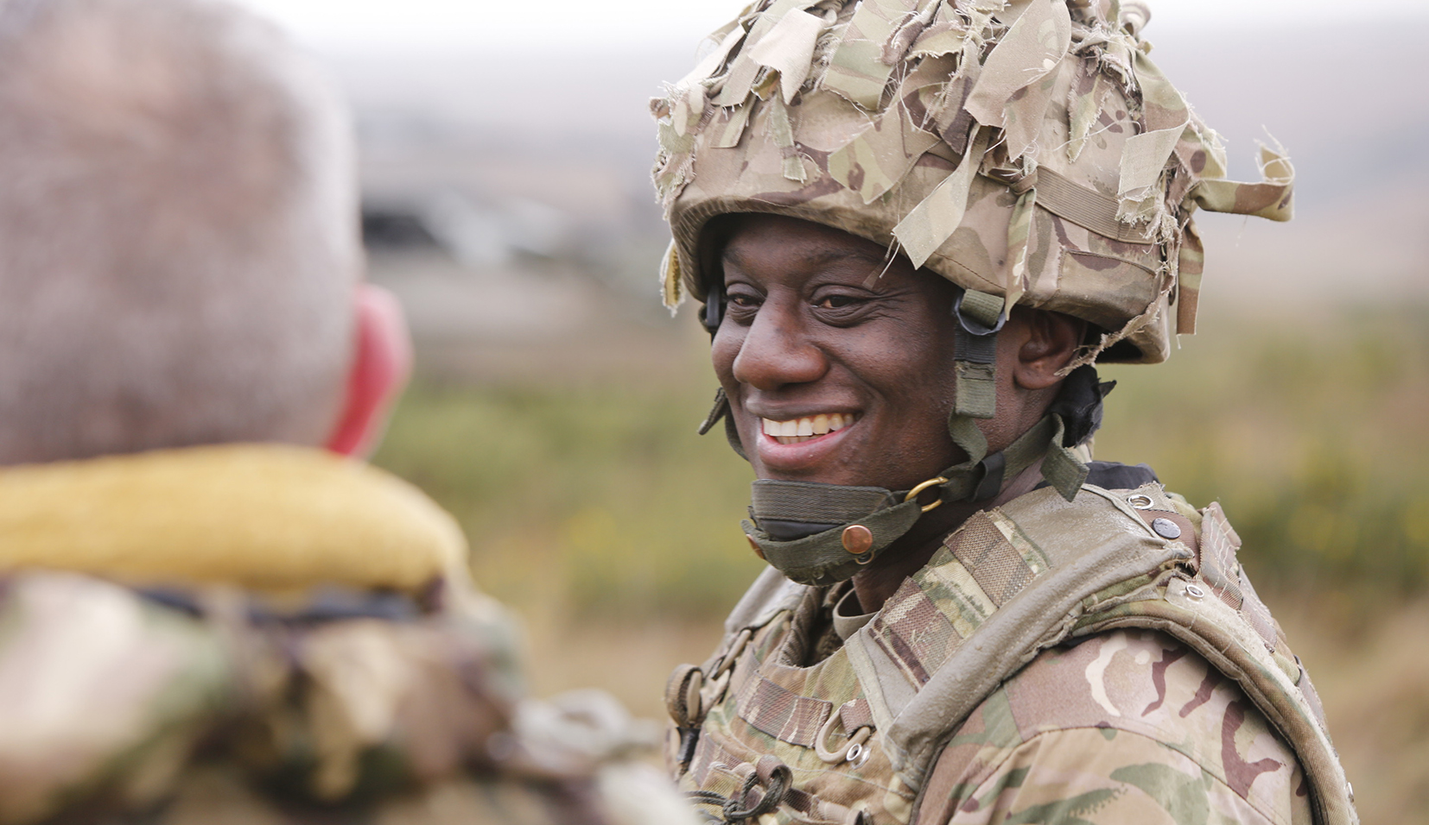

1 min
Rank and experience: A new soldier who has just completed their basic training.
Survival challenge role: Supporting the hiker who has fallen and hurt their ankle and breaking up the fight.
6 | SURVIVAL CHALLENGE

Slide 7
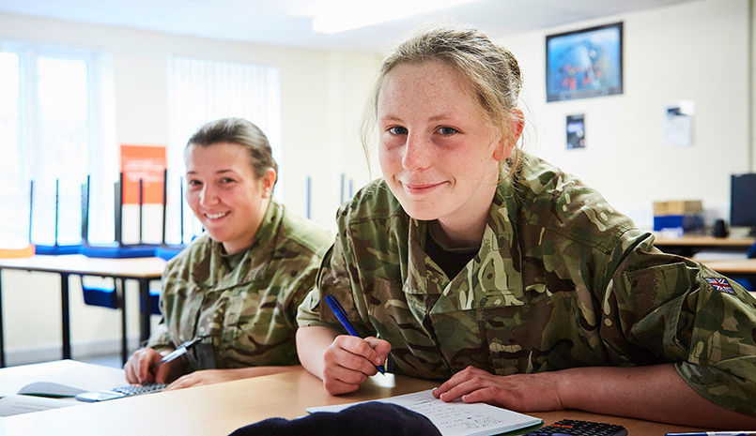
1 min
Rank and experience: Has been in the army for 7 years, gained soldier instructor qualifications, and in charge of Army equipment.
Survival challenge role: In charge of weather tracking, radio, and hiking equipment, seeking help and shelter.
7 | SURVIVAL CHALLENGE

Slide 8
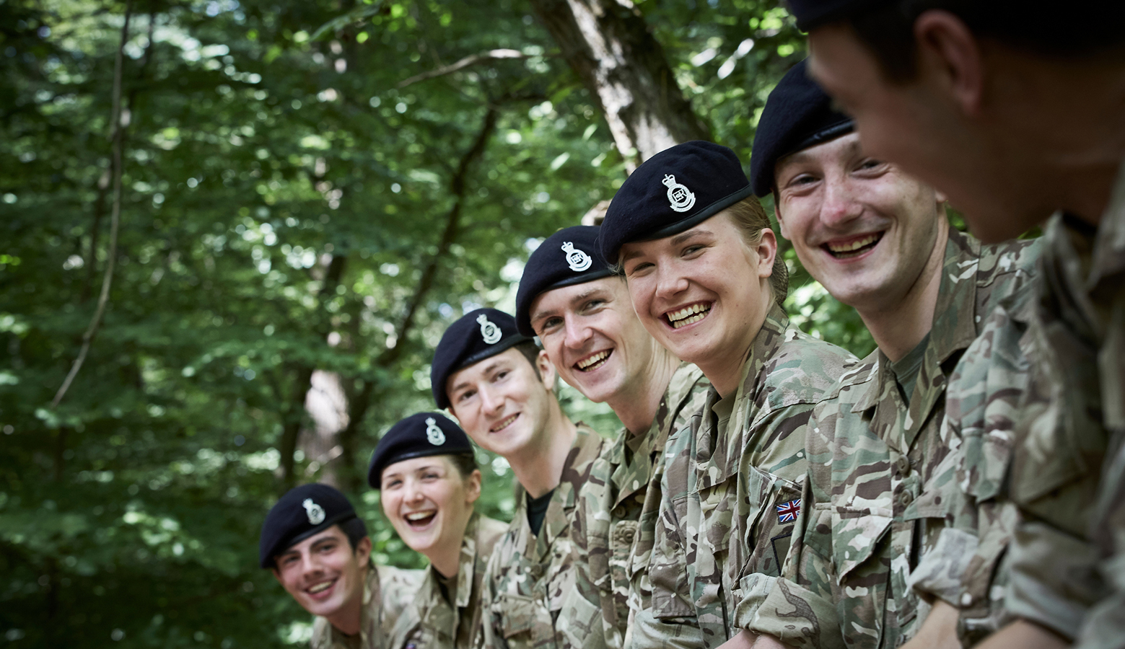

1 min
Rank and experience: Has been in the Army for 12 years, senior role with some responsibility, second in command to a troop of 35 soldiers, advises and assists Junior Officers.
Survival challenge role: Supporting Captain Halston in deciding the best action to take, organising the group and convincing inexperienced people not to leave the hike.
8 | SURVIVAL CHALLENGE

Slide 9
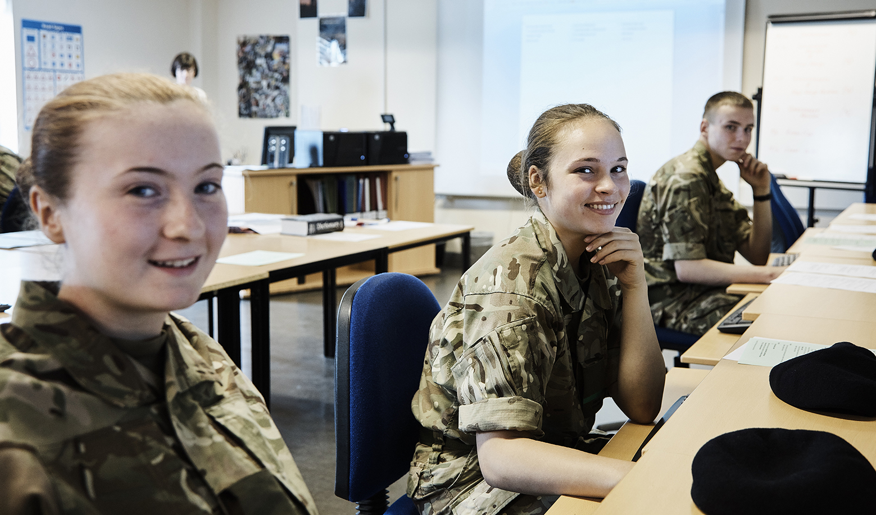

1 min
Rank and experience: Officer level, has held position of Captain for 8 years, main officer in command, key responsibility for planning, decision-making and organising personnel.
Survival challenge role: Deciding each Army leader’s role and planning how to get the group out of the survival challenge situation.
9 | SURVIVAL CHALLENGE

Slide 10

5 mins
A charity hiking trip has been organised in the Yorkshire Dales, with lots of people taking part, including four Army group leaders: Private Arden, Lance Corporal Maxi, Sergeant Alva and Captain Halston.
The first day starts well but then as the day goes on, the weather starts to turn and a sudden storm begins to make the trek increasingly difficult.
One of the group falls, injuring their ankle and can't walk any further. There is no mobile phone signal and the person is in a lot of pain. As the storm continues panic breaks out amongst the group, with some wanting to leave the group and get off of the trek. Two of the group begin arguing and it looks like a fight may break out. Meanwhile the injured person is shivering. The rain is pelting down and the temperature has dropped. Very soon it is going to start getting dark.
Captain Halston checks the Army’s group rucksack, inside there is some rope, a tarpaulin, a bottle of water, some matches, a compass, a pen-knife, a snack bar, a torch, a whistle and emergency blanket.
In your groups, discuss how your assigned Army group leader can help solve the survival challenge?
10 | SURVIVAL CHALLENGE
Notes:
Leave this slide up as the groups discuss and their Army leader’s role and how they could solve the challenge.

Slide 11
5 mins
11 | SURVIVAL CHALLENGE
Notes:
Take feedback from the class, comparing the roles of the Army leaders and suggested solutions.

Slide 12
5 mins
Adaptability, assertiveness, bravery, compassion, ability to complete tasks under pressure, confidence, courage, creative-thinking, decision-making, empathy, enterprise, honesty, integrity, leadership, loyalty, ability to resolve difficulties, management of emotions in stressful or intense situations, management of expectations, management of set-backs, negotiation, organisation, perseverance, persuasiveness, forward thinking, readiness, prioritisation, reliability, resilience, respect, self-belief, self-esteem, sincerity, strength, teamwork
Discuss in your groups and get ready to share with the class.
12 | SURVIVAL CHALLENGE
Notes:
Ask students to discuss in their groups which character traits their Army leader would need to deal with the situation and their role in managing it.
Students can write these on to flip chart paper or be given a copy of the slide to circle or highlight the relevant descriptions and add any additional suggestions.
Give the pupils a few minutes to complete the task, then bring the class back together and take feedback, comparing the character traits needed.

Slide 13

5 mins
Which other jobs and careers need people who can demonstrate these character traits?
What work situations might arise when someone would need to use these?
Which character traits might someone develop at college or further education?
Which aspects of college-life would develop different aspects of character?
13 | SURVIVAL CHALLENGE
Notes:
Ask students to discuss other jobs and careers (including within the Army) where different character traits could be beneficial.
Some students may be able to suggest specific situations.
As an extension activity, the groups could also discuss which of these character traits someone might develop at college or in further education. They could consider which aspects of college-life would develop different aspects of character.

Slide 14
5 mins
Character can be described as positive values and qualities that help us manage different situations. Character helps us decide: What matters here? What is the right thing to do?
Character is developed over time, in a range of contexts (home, school, college, work) and through different situations (with family, friends, peers and colleagues), including known and unknown or unpredictable events.
Click to reveal
Employers (for many different roles) are looking for people with these character traits, including the British Army.
14 | SURVIVAL CHALLENGE
Notes:
Ask the question to the class and discuss answers. Reveal answer here and read out to the class and discuss why it is important.

Slide 15

3 mins
Join the Army Foundation College to find out more about how to build character, core skills and develop your self-confidence. Hosted by KISS FM radio presenter Jordan Lee, hear directly from ex-AFC students, Junior Soldiers and Instructors about life at the college, what is taught and how to apply.
Date: 17th January 2023
Time: 11am
Place: Streamed live from a school in York.
15 | SURVIVAL CHALLENGE
Notes:
Explain to the students that now they have a chance to ask a question at the live assembly.
Give each student a small piece of paper and ask them to write a question – this can be about life at the Army college, roles in the Army, how the Army develops character, or something connected to today’s task.
Ask them to put their question in the box/envelope.
Ensure you read the questions after the session and before the live assembly. Select some questions for students to ask at the assembly session.

Slide 16

3 mins
What question would you like to ask the panel of ex-AFC students, Junior Soldiers and Instructors? It can be related to the Army, developing character or a specific question about AFC Harrogate.
16 | SURVIVAL CHALLENGE
Notes:
Explain to the students that now they have a chance to ask a question at the live assembly.
Give each student a small piece of paper and ask them to write a question – this can be about life at the Army college, roles in the Army, how the Army develops character, or something connected to today’s task.
Ask them to put their question in the box/envelope.
Ensure you read the questions after the session and before the live assembly. Select some questions for students to ask at the assembly session.

Slide 17

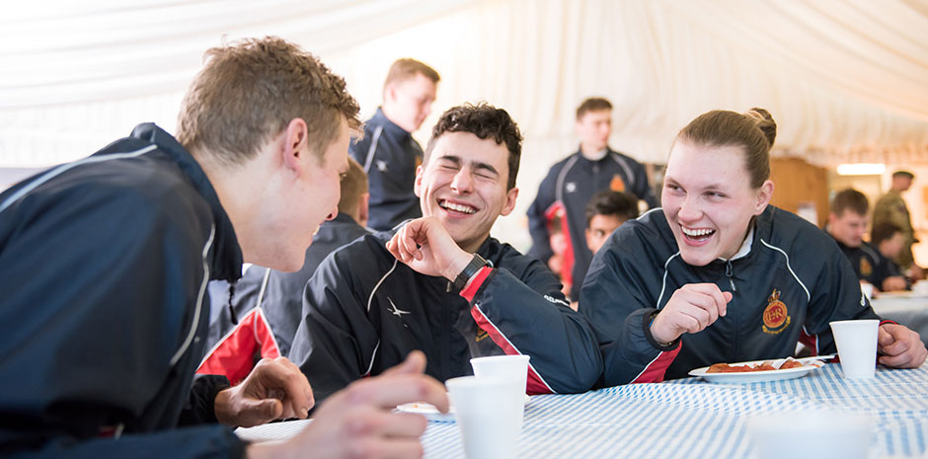
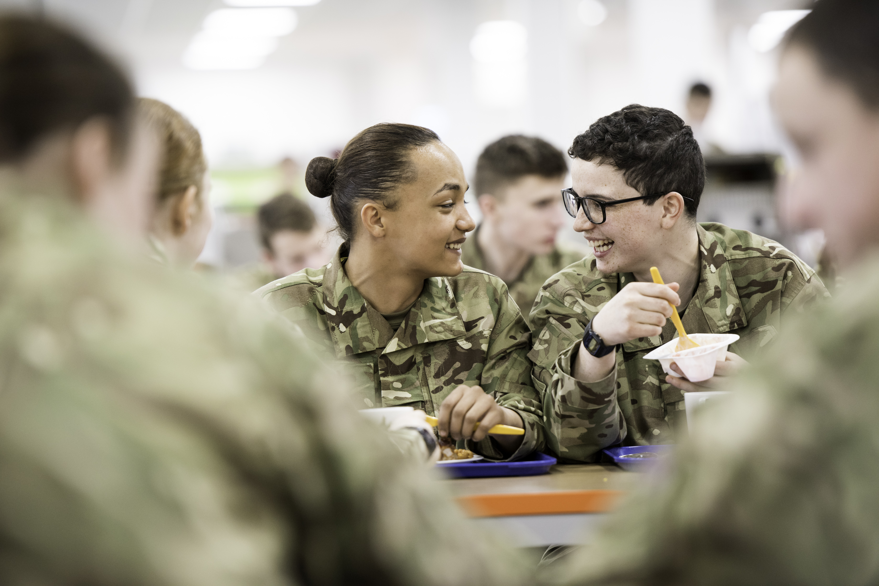





Discover a college experience like
no other for 16 and 17 year olds
starting their career in the British
Army. More
Receive sponsorship through sixth form and university, before joining the Army in a leadership role. More
Explore the 40+ apprenticeship schemes in the British Army, from animal care to vehicle maintenance. More
17 | SURVIVAL CHALLENGE

Slide 18


