Slide 1
An introduction to Specsavers
Dena Wyatt – Head of Apprenticeships

Slide 2
1. Tell us about Specsavers and Apprenticeships
Co-founders Doug and Dame Mary Perkins met at Cardiff University where they were both studying to be optometrists.
In those days, the world of opticians was completely different: you weren’t allowed to advertise, have a window display or even put prices on frames.
Doug and Mary were always very clear that their goal was to provide the best value eyecare to everyone, simply and consistently. They wanted to exceed customer expectations, every time.
Since day one, that vision and our values has guided every decision we have made.
After university, they set up their own business in Bristol which grew to 23 stores. The stores were sold 1980 when Doug and Mary moved to Guernsey.
Notes:
2021 marked the 37th anniversary of Specsavers and although the business has evolved remarkably over more than three decades, one critical element that has remained constant is having passionate and highly-skilled people at the heart of everything we do. Being knowledgeable and accessible is essential to delivering world-class customer experiences, but what our 41 million customers across the globe really remember is great human interactions: the special care and attention that our people provide every day.

Slide 3
Our purpose
To change lives through better sight and hearing
Notes:
Our purpose is what should drive our work every day.
​
We stepped back and, by looked hard at the reasons we exist, which go back to why Doug and Mary started Specsavers back in 1984. At the core, it remains the same, but we wanted to bring it to the forefront of our day-to-day outputs.​

Slide 4
Some things that may come as a surprise about Specsavers
Global business, with over 42,000 colleagues
Joint Venture Partnership
Over 2,300 stores, opening new stores all the time
UK, Ireland, Netherlands, Norway, Sweden, Denmark, Finland, Spain, Australia and New Zealand and new territory Canada

Slide 5
What Apprenticeships are available in Specsavers and what does the learning journey look like?
Employer Provider, which means we are employed by Specsavers – Most of our colleagues worked in store before joining our team
Internally we deliver Optical Assistants, Customer Service and Spectacle Maker.
You have 2 dedicated Coaches -
one to support you with your learning, well being any additional support and make sure you’re on track and one to develop, train coach and support you to learn the role alongside the store.
The learning is bespoke to Specsavers, you are trained by an expert store team and supported by your Coaches. Mix of virtual live sessions and face to face sessions, learn through completing courses, researching, watching your colleagues and getting them to watch you

Slide 6
3/4. What are Specsavers looking for in an apprentice? Are there any minimum requirements? Are there many vacancies and how would you apply for an Apprenticeship?
221 Live vacancies
Want to learn, passionate about people, and helping people, enthusiastic
At least a C/4 in Maths for Level 3 programmes
Apply via our careers page or pop in store

Slide 7
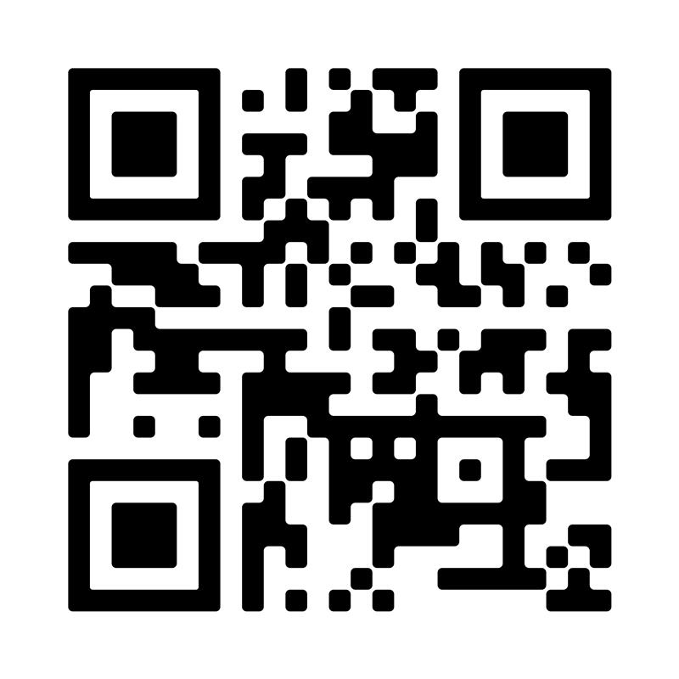

Slide 8
Our Career Opportunities
Manager or In store Trainer
Lab Technician
Optical Assistant or Dispensing Optician
Hearing Care or Contact Lenses
Optometrist
Welcome to Apprenticeships at Specsavers

